Slide 1


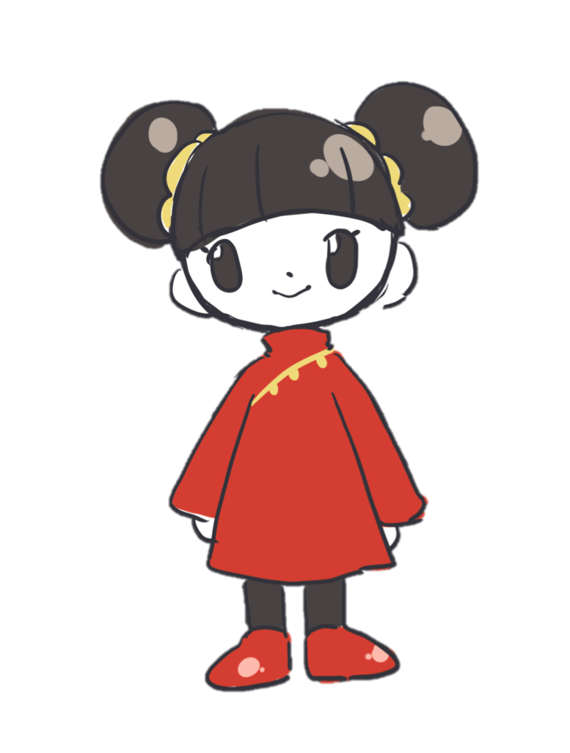

Ashley Vargas, Karina Vargas, Christina Cuneo, and Rachel Lau

Slide 2

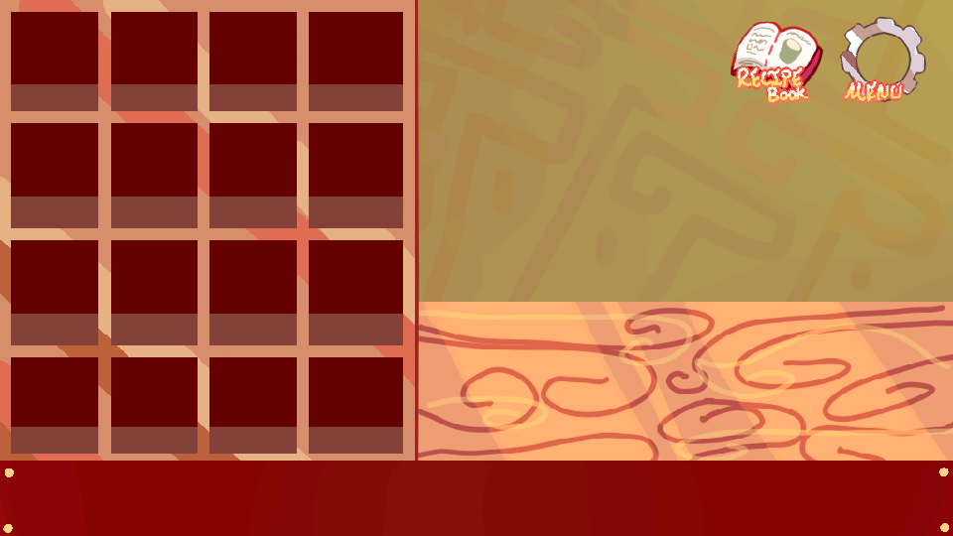
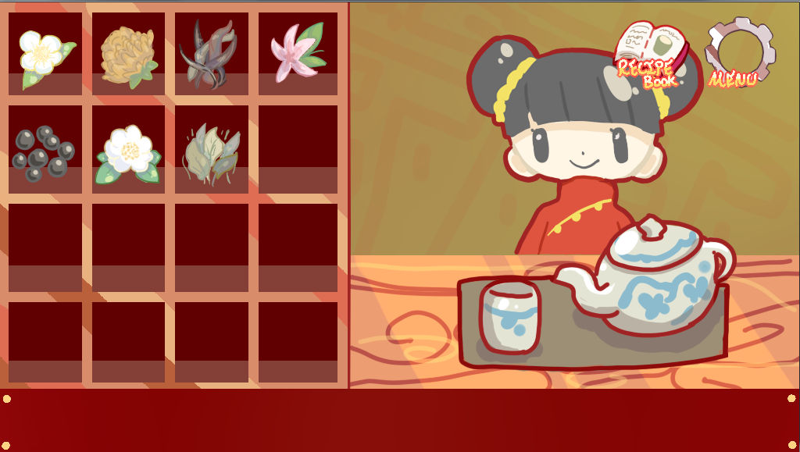
Before & After:
Sprint 1
Sprint 2

Slide 3
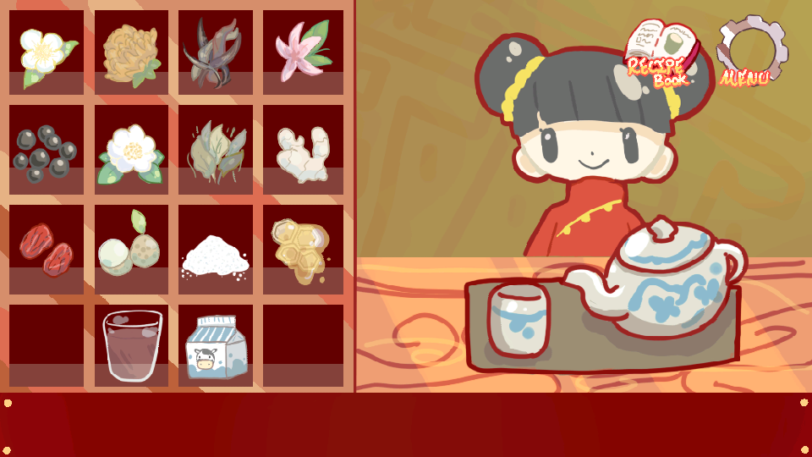

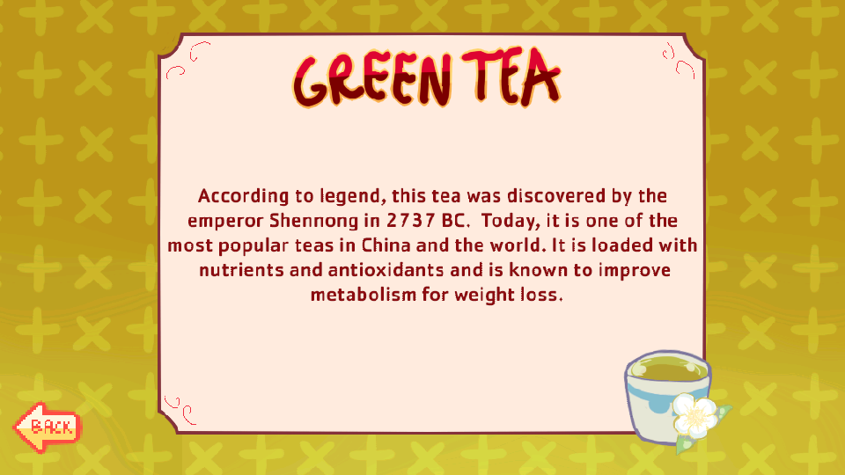

Screenshots of our app:

Slide 4
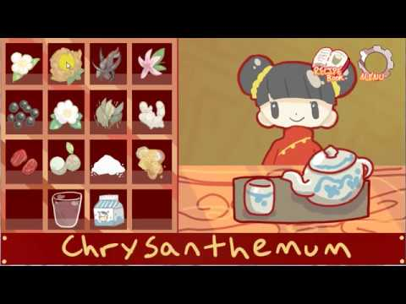
Video:

Slide 5
Retrospective:
8 User Stories planned.7 were implemented.
No new stories were added, backlog remained the same.
Worked at a good pace, procrastinated a bit though.

Slide 6
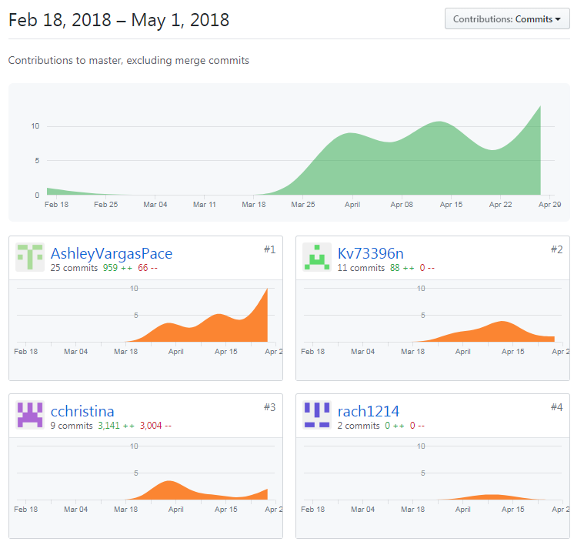
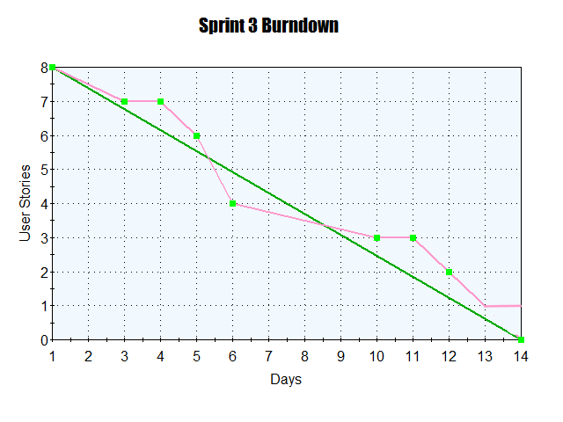
Stats and Burndown:

